Slide 1
Box Works – Jump Start Java
Ryan Schaller, Kyle Adams

Slide 2
1) Introduction 2) Developer Console Setup 3) Sample Java Project 4) Questions
Agenda

Slide 3
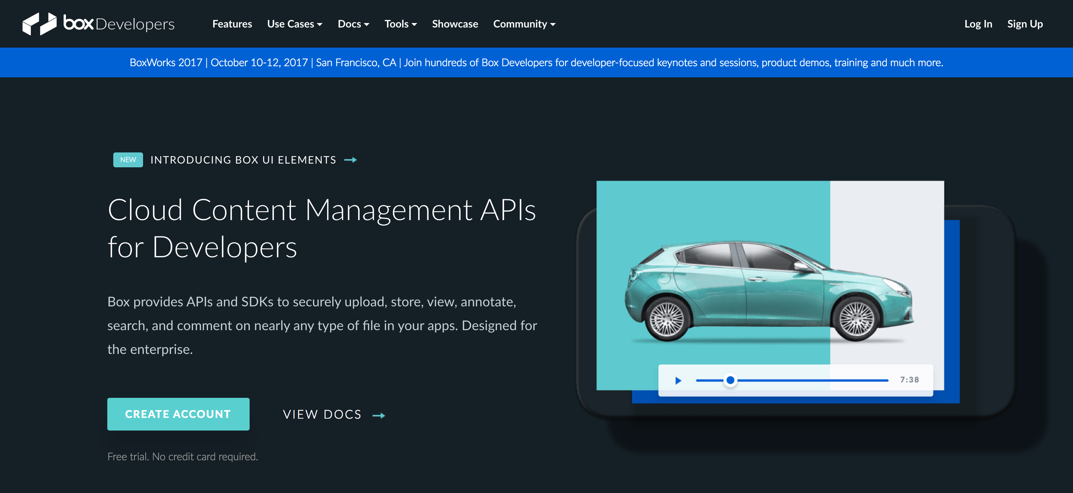

Slide 4













Key Management
Content
Metadata
Collaboration
Workflow
Data Residency
Box, one platform that works for all your content
Compliance
API
Information Governance
Data Protection Policies

Slide 5
Token Overview
OAuth 2 with JSON Web Tokens
OAuth 2 with JSON Web Tokens enables an application to connect directly to Box and obtain authorization to access files and folders without requiring users to log in. Using OAuth 2 with JSON Web Tokens an application can provide Box features without users even being aware that Box exists.
OAuth 2
OAuth 2 requires a user to log in to Box and grant your application permission to access files and folders. The OAuth 2 standard defines a three-legged authentication process; Box conforms to this process.
Token Exchange
Token Exchange is a mechanism to exchange a parent token (Managed/App User, Service Account or App Token) for a child token, which is scoped down to the the minimum set of required permissions so it can be securely sent down to the client without elevating client privileges.

Slide 7
Developer Console & Sample App

